Slide 1
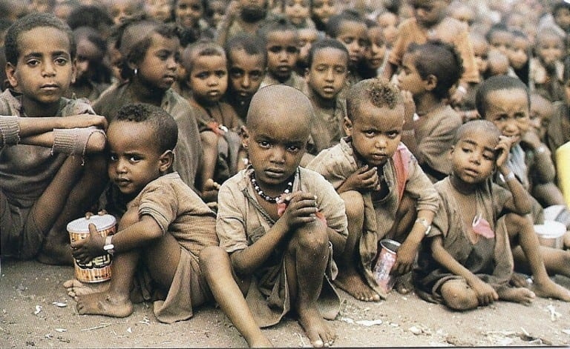
FOOD TO FEED ZERO HUNGER
by FRONTLINERS
This Photo by Unknown author is licensed under CC BY-SA.

Slide 2
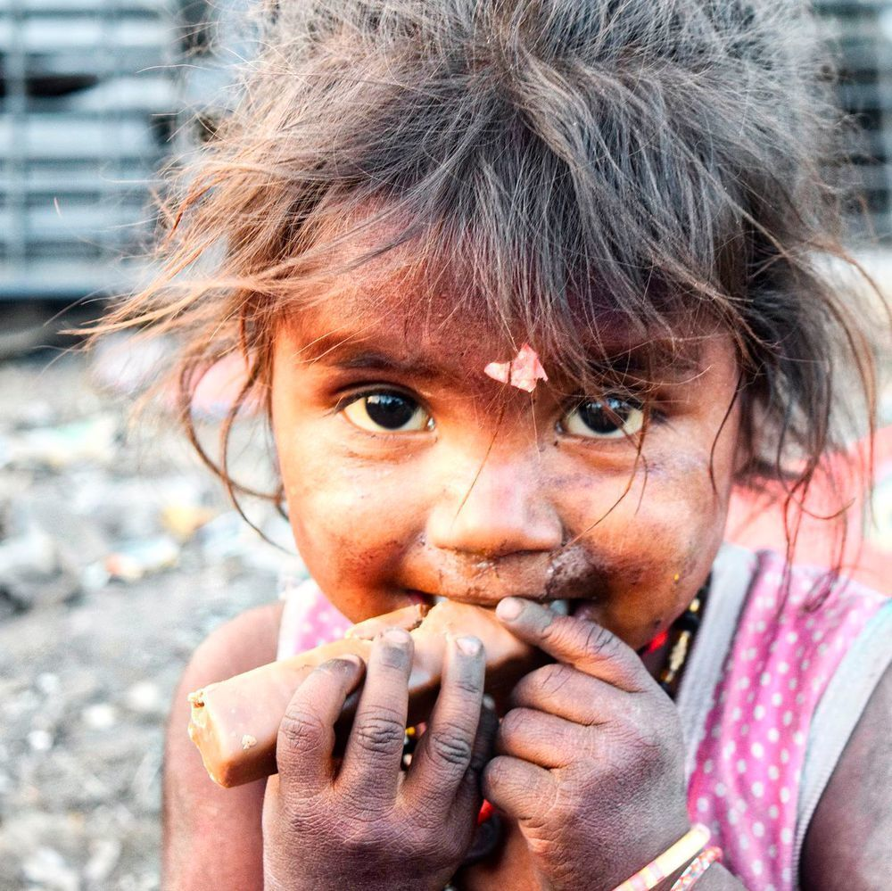
What is GLOBAL HUNGER?
189.2 million people are undernourished in India
as many as 811 million people still go hungry.
A quarter of women of reproductive age in India are undernourished

Slide 3
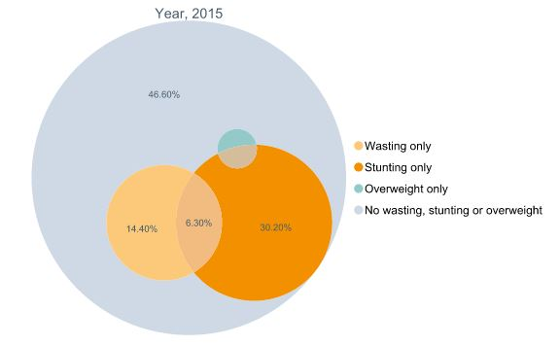
Why we need to Fight Hunger now!
By the year 2027 Indian population will be the highest in the world (Surpassing China) and likely to miss global nutrition targets by 2025.
1.8 million homeless individuals living in India as of 2019.
4500 children die every day under the age of five years in the country due to hunger and malnutrition

Slide 4
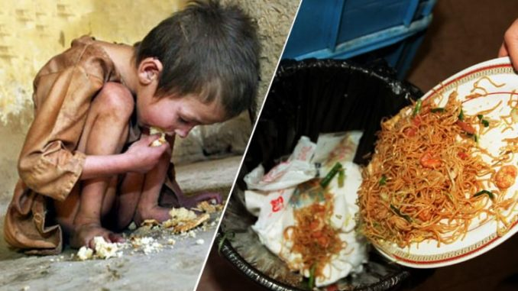
Our Solution is to eradicate Global Hunger
Nearly 40 percent of the food produced in India is wasted every year due to fragmented food systems and inefficient supply chains
we will break this inefficient supply chain, and establish a better and effective food distribution system
An App to provide a solution to food waste and distribute the residual food to the needy

Slide 5
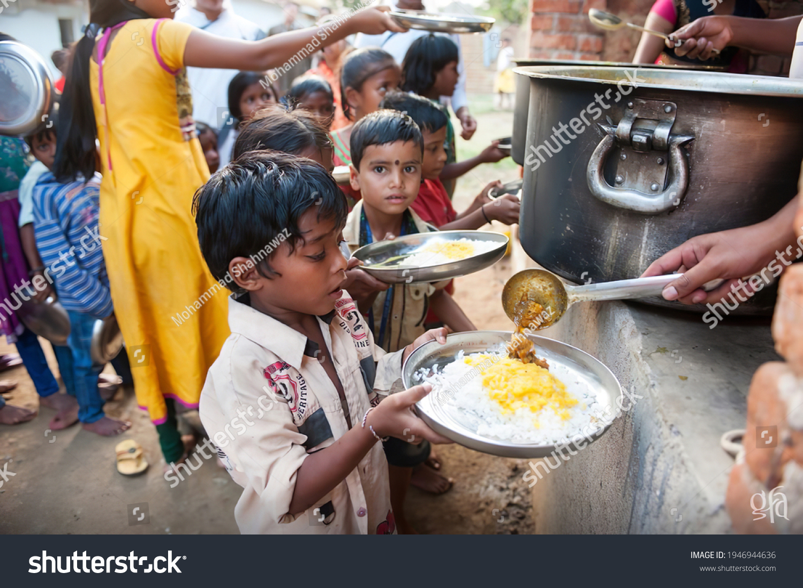
Food to Feed Innovative Functionality and Vision
Collect food from Restaurants, Marriage Houses, Home Occasions, etc..
Save and Store the food at the Central Storage
Identifying the Hunger HotSpots
Food Distribution at the HotSpots

Slide 6
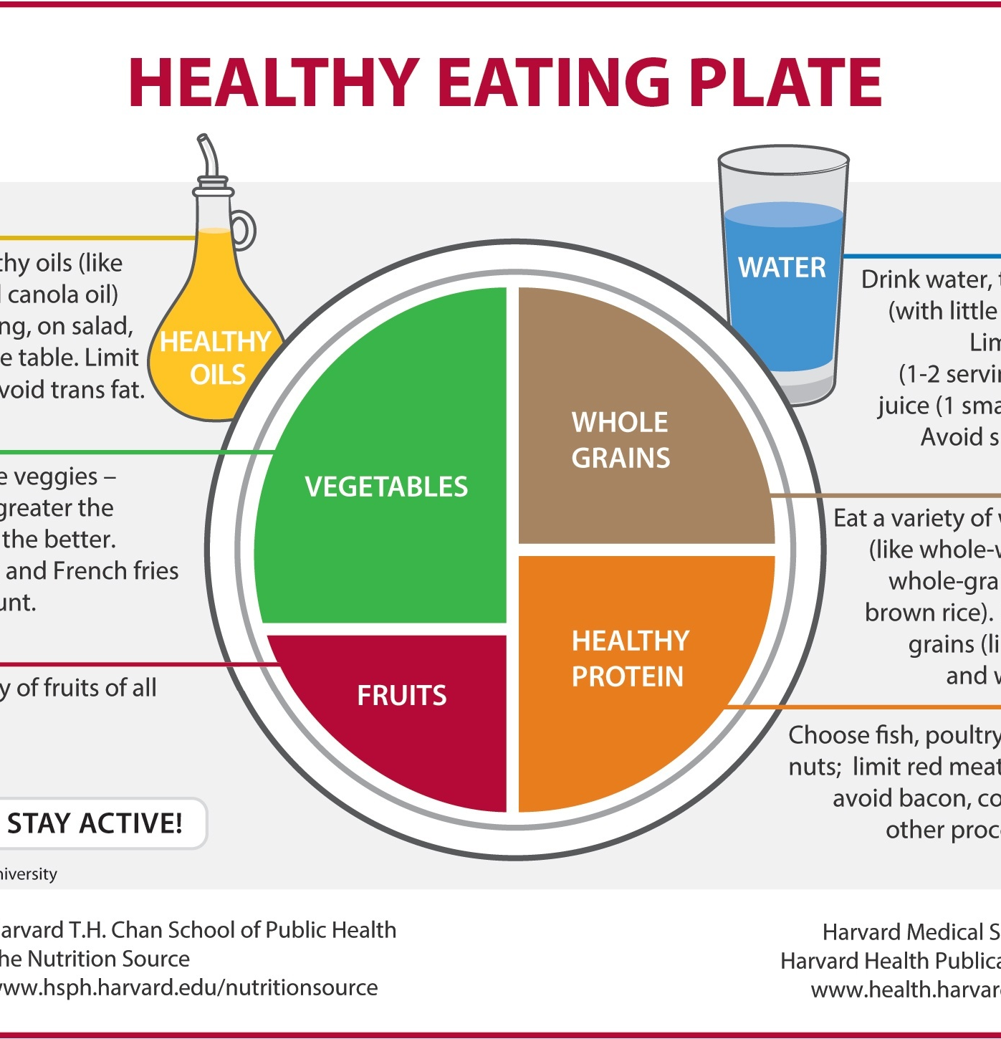
Continue..
Promote Healthy Food Habit
Provide Diet and Nutrition plans according to Age, Weight, Height and Gender.
Keeps track of Clorie and Water Intakes through out the day
Special section for Women anemia and malnutrition during pregnancy.
This Photo by Unknown author is licensed under CC BY-SA-NC.

Slide 7

Tech Stack Implementation Plans
Android App ( by Android Studio)
Language Used: Java
Location Services (Support from Google Maps API)
Database Used: Firebase DataStore
Nutrition API to provide nutrition and Diet plans (Fatsecret Platform API)
This Photo by Unknown author is licensed under CC BY-NC.
This Photo by Unknown author is licensed under CC BY-NC.

Slide 8
THANK YOU

